Slide 1

PEA – 516
Lecture – 16
Compound Interest

Slide 2
Compound Interest:
Compound interest is the interest earned not only on the original principal, but also on all interests earned previously
Let Principal = P, Rate = R% per annum, Time = n years.
When interest is compounded Annually:
Amount= P(1+R/100)^n
2. When interest is compounded Half-yearly:
Amount=P[1+(R/2)/100]^2n
3. When interest is compounded Quarterly:
Amount=P[1+(R/4)/100]^4n

Slide 3
Compound interest
If P= Rs.1000, R=10% p.a. T=3 years. Find Compound Interest for 3 years.

Slide 4
Question: Find the compound interest earned on Rs.20000 for 2 years at 10% p.a. the interest being compounded annually.
[A] Rs.2100
[B] Rs.4200
[C] Rs.6300
[D] Rs.5600

Slide 5
Question: Find CI. If P= Rs. 10000, r = 10 % p.a. and T= 1 year and 73 days.
[A] Rs.2220
[B] Rs.3200
[C] Rs.2120
[D] Rs.1220

Slide 6
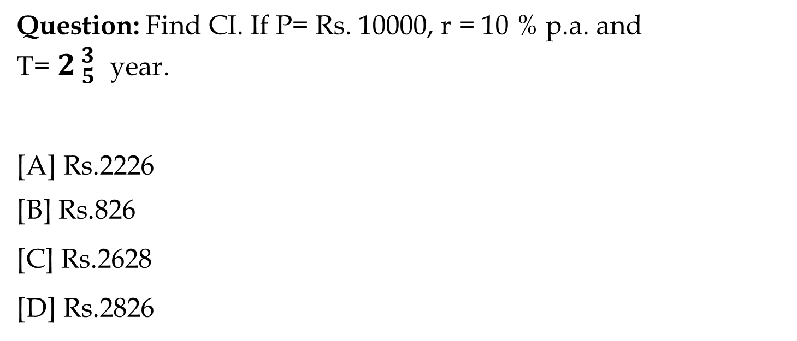
Question: Find CI. If P= Rs. 10000, r = 10 % p.a. and
T=${ 2}_{ 5}^{ 3}$year.
[A] Rs.2226
[B] Rs.826
[C] Rs.2628
[D] Rs.2826

Slide 7
Question: Find the interest earned in the first year on Rs.400 at 20%p.a. compound interest, the interest being compounded half yearly.
[A] Rs.42
[B] Rs.72
[C] Rs.84
[D] Rs.144

Slide 8
Question: Find C.I. on Rs. 8000, 20% P.A. For 9 month compounded quarterly.
[A] Rs.262
[B] Rs.1261
[C] Rs.9261
[D] Rs.831

Slide 9
Question: A sum of money under compound interest doubles itself in 4 years. In how many years will it become 16 times itself?
[A] 12 years
[B] 16 years
[C] 8 years
[D] None of these

Slide 10
Question: A sum doubles in 8 years at compound interest. In how many years will the sum become 4 times the original sum if the interest is compounded annually?
[A] 16 years
[B] 24 years
[C] 64 years
[D] 32 years

Slide 11
Question: If Rs.2000 amounts to Rs.2880 in 2 years at compound interest, what is the rate of interest per annum if the interest is being compounded annually?
[A] 10%
[B] 20%
[C] 15%
[D] 25%

Slide 12
Question: Divide Rs. 6100 between A & B, so that A’s share at the end of 3 year = B’s share at end of 5 year. C.I. Rate =20% pa.
[A] 3600, 2500
[B] 2000, 4100
[C] 2500, 3600
[D] 4100, 2000

Slide 13
Question: A sum of money lent at C.I. For two years at 20% pa give Rs. 723 more if the interest was half year in place of annually. The sum is.
[A] 30000
[B] 60000
[C] 40000
[D] 20000

Slide 14
Question: If the S.I of certain money for 3 years is Rs. 225 & C.I on same money, same rate for 2 years is Rs. 153. then what was the principal amount?
[A] Rs.875
[B] Rs.1875
[C] Rs.785
[D] Rs.1785

Slide 15


